Slide 1

British Airways Analysis from customer prediction

Slide 2
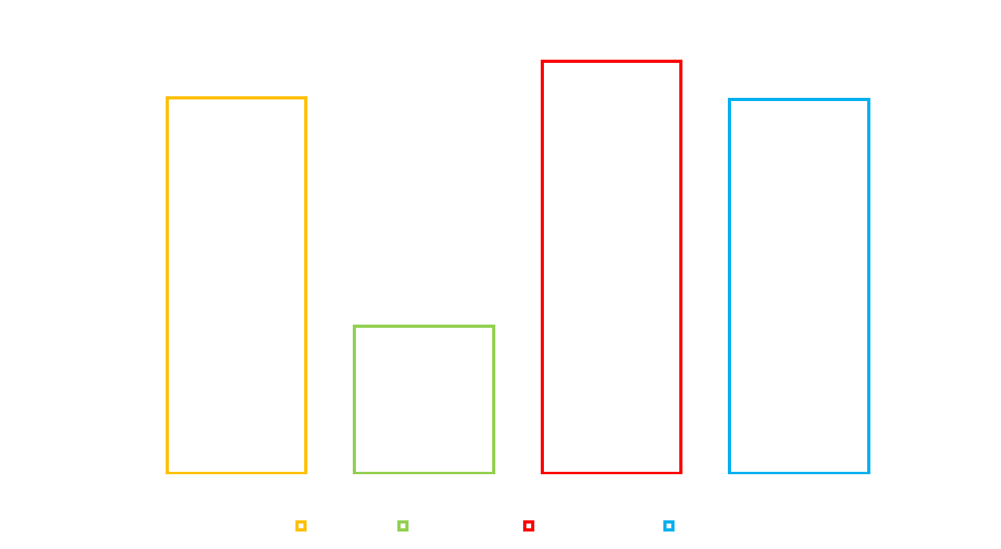
INSIGHTS
Feature importance
Evaluation Report
The pivotal variable influencing the model was the "purchase_lead," denoting the time interval between purchase and departure. Notably, factors related to the flight, such as flight time and duration, demonstrated significance, whereas the booking origin of the customer did not contribute significantly.
The models, namely AdaBoost, Decision Tree, Random Forest, and ANN, exhibited accuracies of approximately 0.6925, 0.6424, 0.7005, and 0.6922, respectively. Among these, Random Forest yielded the highest accuracy. However, these results underscore the potential for model enhancement. I recommend augmenting the models with additional customer-centric features to refine predictive capabilities and address areas for improvement.

